Slide 1
Forecasting Analytics
Session 5

Slide 2
Building seasonality into ARIMA models
Consider monthly data with annual seasonality
The seasonal phenomena may not be restricted to a fixed periodic pattern
In fact, anything that happens in a non-seasonal series (governed by UNIT LAG) can happen in a seasonal series at a larger time scale (LAG 12).
Such happenings can be represented by an ARIMA-like model that operates as lag 12.
Call it ARIMA(P,D,Q).

Slide 3
A combined ARIMA model
A combined model would have two levels:
one ARIMA(p,d,q) for lag 1,
another ARIMA(P,D,Q) for lag 12.
The two layers can co-exist.
It does not matter which one comes first, the model happens to be the same either way.
Such a model is called a seasonal ARIMA model.
It can even be implemented in R.

Slide 4
Example: Seasonal ARIMA modeling of US retail sales data
Code to automatically fit seasonal ARIMA model
auto.arima(log(Tab31Ats))
Produces ARIMA(1,1,3)(2,1,1)₁₂ model, but has computational problem
Code to fit ARIMA(1,1,3)(2,1,1)₁₂ model
Tab31Afit <- arima(log(Tab31Ats),order=c(1,1,3),seasonal=list(order=c(2,1,1),period=12))
summary(Tab31Afit)
Produces appropriate estimates and diagnostic information

Slide 5
Forecast of US retail sales from Seasonal ARIMA modeling
Code to generate ARIMA forecast
Tab31Afore <- predict(Tab31Afit, n.ahead=12)
lpl <- Tab31Afore$pred-2*Tab31Afore$se
upl <- Tab31Afore$pred+2*Tab31Afore$se
cbind(exp(Tab31Afore$pred), exp(lpl), exp(upl))
Produces forecasts and prediction intervals
Additional code to generate plots
plot.ts(Tab31Ats,xlim=c(1983,1997))
lines((1996+(0:11)/12),exp(Tab31Afore$pred),col=4)
lines((1996+(0:11)/12),exp(lpl),col=3)
lines((1996+(0:11)/12),exp(upl),col=2)

Slide 6
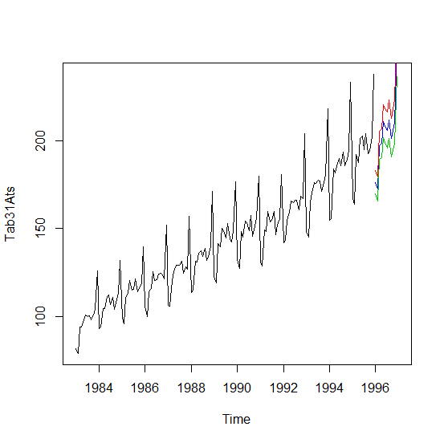
Forecast of US retail sales from Seasonal ARIMA modeling

Slide 7
Revisit decomposition approach: How to recombine components?
In an additive model
add the forecasts of the components
add the variances of the components (generally an approximate but conservative approach)
In a multiplicative model, the same strategy can be taken in log-scale
Anti-log or exponential function brings back the forecasts to original scale
Upper and lower prediction limits can be transformed similarly; they would continue to have the same coverage probability.

Slide 8
Importance of error estimates
In order to provide an estimate of the overall forecast error, or to provide prediction intervals, error estimates for each component is needed.
Simple decomposition may provide an idea of what to expect, but it does not give error estimates.
Attempt a fresh decomposition, while looking for error estimates all the way.
One route will be illustrated; not unique.

Slide 9
Step 1: Fit trend model, generate forecast & error estimates from regression model
Code for this purpose (working with log series)
time <- 1983 + (0:155)/12
Tab31Alog <- log(Tab31A)
Tab31A.df <- as.data.frame(cbind(time,Tab31Alog))
Tab31A.new <- data.frame(time = c(1996+(0:11)/12))
logtrend <- predict(lm(Tab31Alog~time), newdata=Tab31A.new, se.fit=TRUE)
logtrendfit <- Tab31Alog - lm(Tab31Alog~time)$resid
logtrend has the prediction information
logtrendfit has the fitted curve within the time span of available data

Slide 10
Step 2: Get seasonal component with error estimates by averaging de-trended series
Code for this purpose
Tab31Adetrended <- Tab31Alog - logtrendfit
Tab31Amat <- matrix(Tab31Adetrended,ncol=12,byrow=T)
logseason <- colMeans(Tab31Amat)
logseason.var <- rep(0,12)
for (i in 1:12) logseason.var[i] <- var(Tab31Amat[,i])/(156/12)
logseason has the seasonal estimate
logseason.var has the estimated variance

Slide 11
Step 3: Get forecast of random part, with error estimates, by ARIMA modeling
Code for obtaining random component and modeling
Tab31Arandom <- Tab31Adetrended - rep(logseason,13)
auto.arima(Tab31Arandom)
This produces ARIMA(0,1,1) model, but has computational problem
Use arima directly with specified model order:
Tab31Aranfit <- arima(Tab31Arandom,order=c(0,1,1))
Tab31Aranfore <- predict(Tab31Aranfit, n.ahead=12)
Tab31Aranfore has prediction information

Slide 12
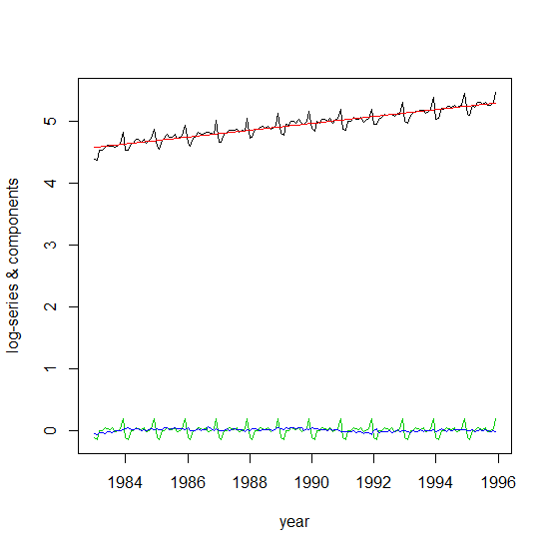
The original log-series and the separated components

Slide 13
Step 4: Re-combine forecasts, add variances, generate prediction intervals
Code for this purpose
Tab31Alogcombpred <- logtrend$fit + logseason + Tab31Aranfore$pred
Tab31Alogcombse <- sqrt((logtrend$se.fit)^2 + logseason.var + (Tab31Aranfore$se)^2)
lfl <- Tab31Alogcombpred-2*Tab31Alogcombse
ufl <- Tab31Alogcombpred+2*Tab31Alogcombse
cbind(exp(Tab31Alogcombpred), exp(lfl), exp(ufl))
Code for producing forecast plot
plot.ts(Tab31Ats,xlim=c(1983,1997))
lines((1996+(0:11)/12),exp(Tab31Alogcombpred),col=4)
lines((1996+(0:11)/12),exp(lfl),col=3)
lines((1996+(0:11)/12),exp(ufl),col=2)

Slide 14
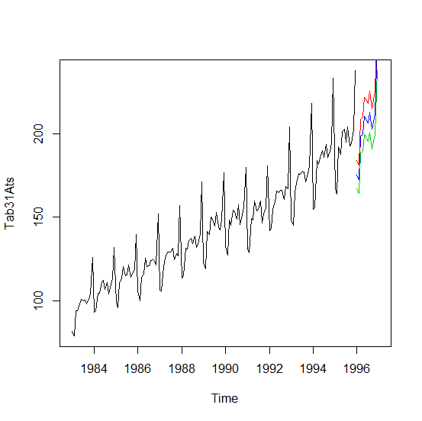
The original series, one-year ahead forecast and prediction intervals

Slide 15
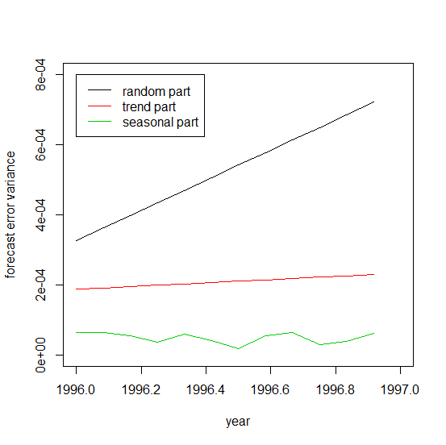
Comparison of different components of forecast error variance

Slide 16
Forecast from generalized exponential smoothing
Code for this purpose
Tab31AHWfit <- HoltWinters(Tab31Ats, beta=TRUE, gamma=TRUE)
lhwl <- (forecast(Tab31AHWfit, h=12)$lower)[,2]
uhwl <- (forecast(Tab31AHWfit, h=12)$upper)[,2]
cbind(forecast(Tab31AHWfit, h=12)$mean, lhwl, uhwl)
Code for producing forecast plot
plot.ts(Tab31Ats,xlim=c(1983,1997))
lines((1996+(0:11)/12),forecast(Tab31AHWfit, h=12)$mean,col=4)
lines((1996+(0:11)/12),lhwl,col=3)
lines((1996+(0:11)/12),uhwl,col=2)

Slide 17
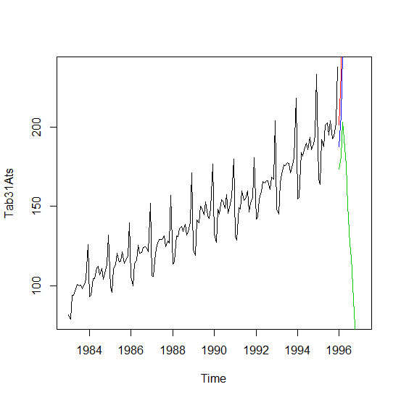
Forecast from generalized exponential smoothing

